Slide 1
Central Limit Theorem

Slide 2
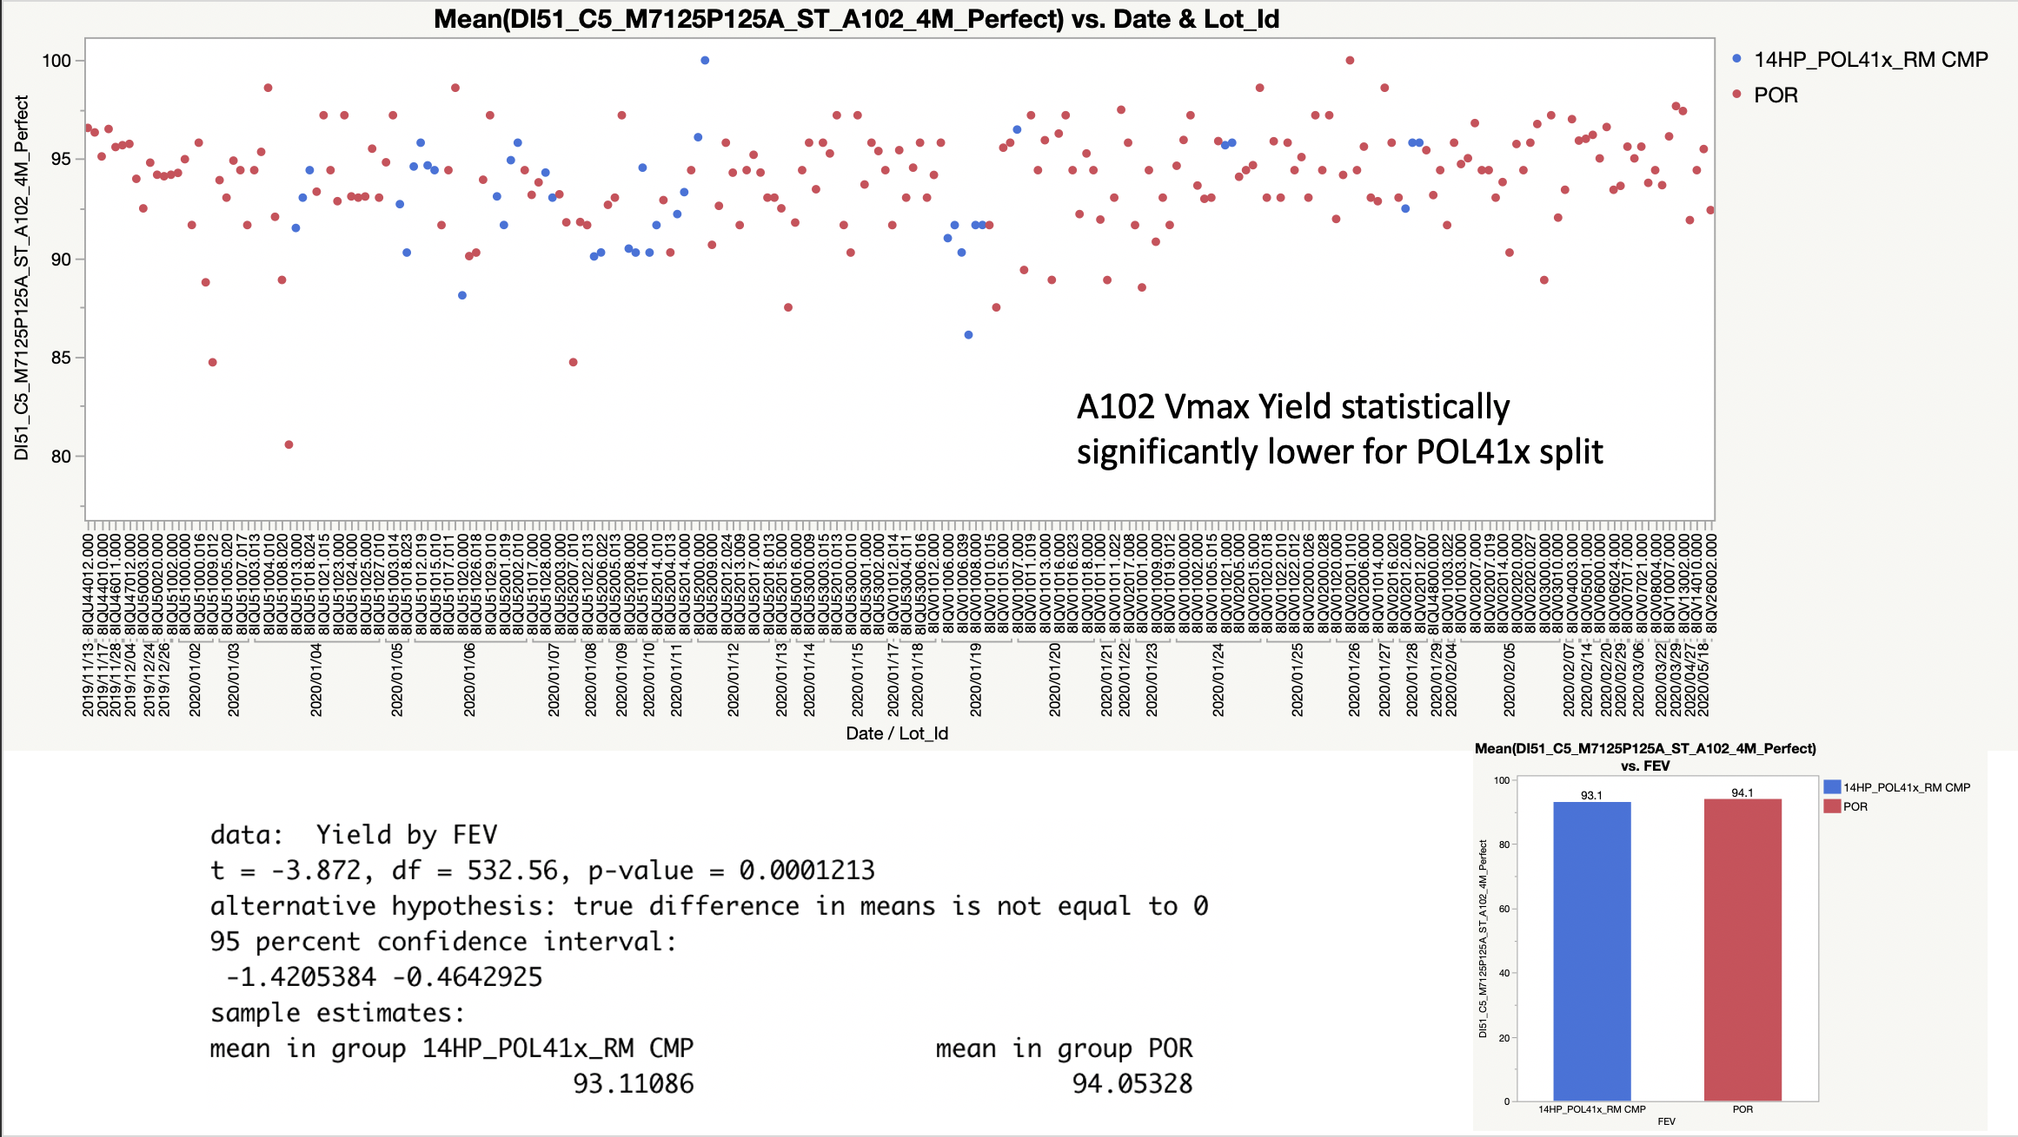

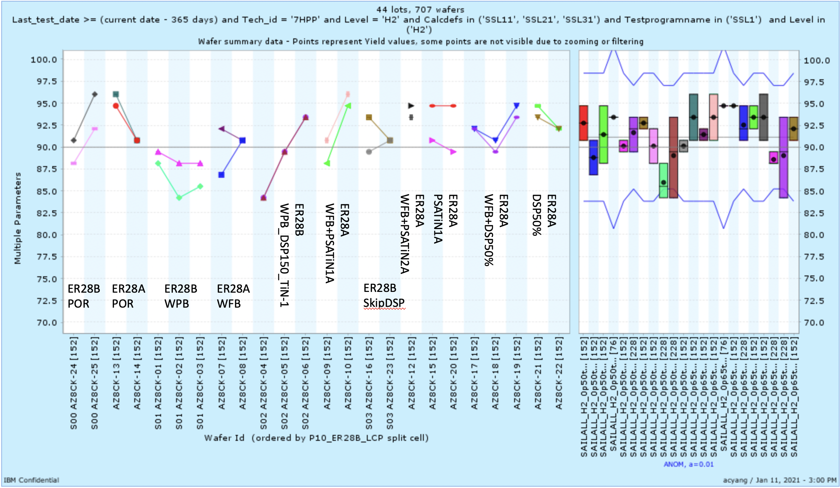
Motivation
Notes:
We’ve all taken averages of splits and compared them to see if there is a positive or negative impact on yield.
We’ve done 2 sample T-test to see if two populations are statistically part of the same population or not.
Why do we do this? Why is it allowed and how much should we believe in our findings?

Slide 3
Central Limit Theorem
Key concepts:
Population distribution: the entire distribution. Most of the time we want to represent the population, but it is impossible to actually measure the population
Normal/Gaussian Distribution
Random Sampling
Sampling Distribution of Means
The central limit theorem tells us that if we take large enough samples from a population, the mean of the samples (aka sampling distribution), will fall within a normal distribution. Regardless of the distribution of the original population.

Slide 4
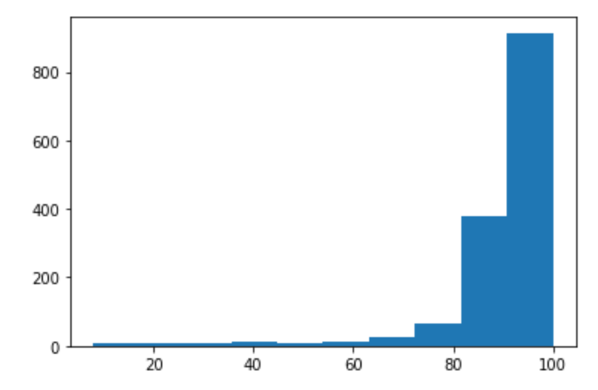


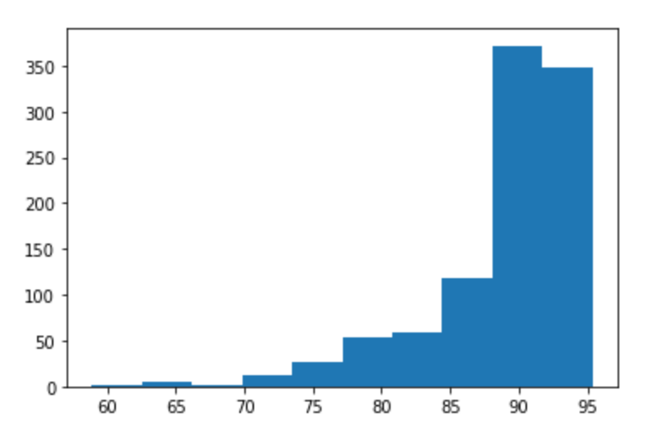
The idea of the central limit theorem is that if we take random samples of size N from this population, the mean of the samples will fall under a normal distribution.
This is our 14nm Diagon yield population
Clearly not a normal distribution, strongly skews to the left.
Population mean (88.78)
Take 5 random samples
Take the mean
You can see that the resulting histogram of means is starting to shift towards a normal distribution. However, it is far from normal.
Repeat this 1000 times and plot the histogram.

Slide 5
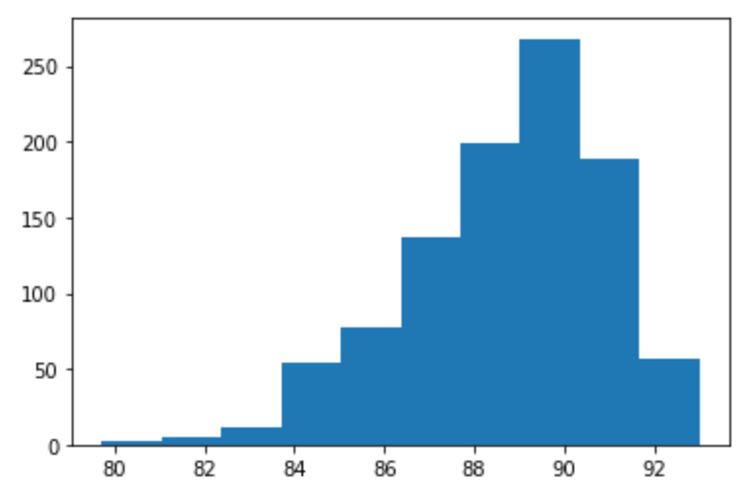
This is our 14nm Diagon yield population
Clearly not a normal distribution, strongly skews to the left.
Now, lets take 30 random samples, calculate the mean. Repeat 1000 times and plot the distribution
Notice that the resulting distribution of means is much more Gaussian and less skewed.

Slide 6
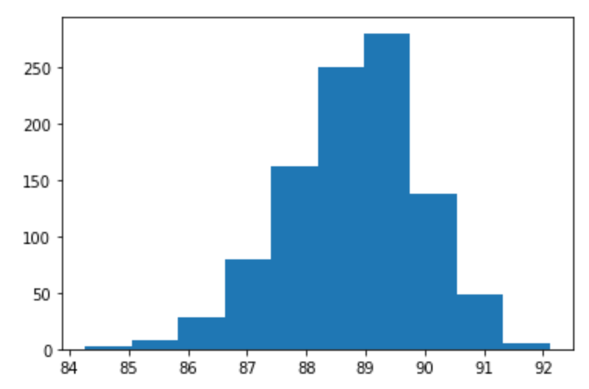
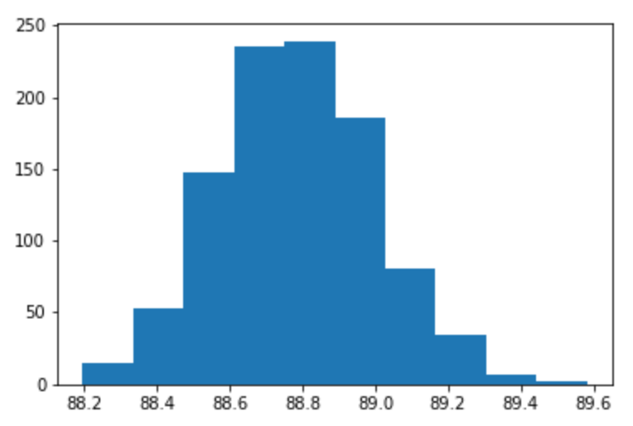
Distribution of means with N = 100
Distribution of means with N = 1000

Slide 7
Key point
As we increase sample size N, the resulting distribution of means becomes more and more Gaussian and the standard deviation becomes smaller
What does this mean?
If you have a large sample, the mean of that sample would have a higher probability of representing the true population mean

Slide 8
Other observations
No matter what the distribution of the population is, the sampling distribution of means will always approach a normal distribution.
Importance: we don’t have to worry about what the distribution of the actual population is
The more ”un-normal” the population distribution is, the more samples we should take to get a good prediction of the mean of the population.

Slide 9
Practical usage/ Why is this important?
We want to know the mean of a population but we cannot possibly measure and compute all of those data points.
Or in the case of wafer data, we want to hypothetically be able to produce thousands of wafers with a specific process, can find out the average yield of these wafers. However, this is impossible.
The central limit theorem proves that we can do something that we subconsciously already know. That we can take a sample of wafer yields to estimate what the mean of the population is.
Central limit theorem also lets us understand that if our sample is too small, the calculated mean might not actually be a good representation of the population mean.

